Slide 1
Handbook of Soccer Match Analysis: A Systematic Approach to Improving Performance 足球比赛分析手册：一种提高比赛成绩的系统方法
Christopher Carling, A.Mark Williams and Thomas Reilly

Slide 2
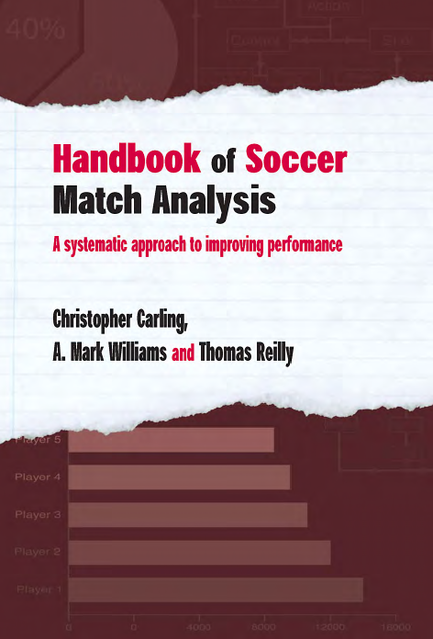

Slide 3
作者介绍：
Christopher Carling is a lecturer and consultant in match analysis. He is based at France’s National Institute of Sport and Physical Education (INSEP) in Paris.
A. Mark Williams is Professor of Motor Behaviour at Liverpool John Moores University, UK. He has worked as a consultant to several professional clubs and National Federations.
Thomas Reilly is Director of the research institute for Sport and Exercise Sciences at Liverpool John Moores University, UK and President of the World Commission of Science and Sports.

Slide 4
本书简介：
Analysing individual and team play is essential when improving performance in soccer, but identifying the right information and putting it to good use can be difficult. This is the first book to focus entirely on match analysis in the game of soccer. Representing an essential and unique resource, this handbook looks at the very latest in match analysis research, and at the innovative technologies being used by professional clubs. Bridging the gap between theory and practice, it documents the methods by which coaches, sport scientists and fitness coaches can improve individual and team performance in soccer.
The following areas are covered:
■ tactics, technical ability and physical fitness
■ how to supply objective feedback to players
■ how to develop specific training routines
■ manual, video and computerised match analysis systems
■ current research findings in soccer match analysis

Slide 5
目录 contents
Chapter 1 Introduction to Soccer Match Analysis
Introduction
The Nature and Origins of Match Analysis
Why Match Analysis is Undertaken
When to Analyse
Summary
Chapter 2 Developing a Manual Notation System
Introduction
Deciding What Information is Needed and Why
How to Design a Hand-based Notation System
Determining the Accuracy and Reliability of the Data
Collating and Presenting the Data
Summary

Slide 6
目录 contents
Chapter 3 Video and Computerised Match Analysis Technology
Introduction
Video Technology
Why Use Video?
Existing Digital Video Systems
Computerised Match Analysis Systems
The First Systems
Modern Systems
Database Technology
Summary
Chapter 4 General Advice on Analysing Match Performance
Introduction
Preparation for and Carrying Out Match Analysis
Advice on Choosing a Personal Computer System
Advice on Choosing Audio-visual Equipment
Advice on Choosing a Match Analysis System
Summary

Slide 7
目录 contents
Chapter 5 Analysis and Presentation of the Results
Introduction
Looking at the Results
Computer Graphics
Qualitative Information
Using Match Analysis Feedback during Team Talks
Team-talk Scenario
Avoiding Potential Pitfalls with the Analysis and Evaluation of Results
Summary
Chapter 6 Motion Analysis and Consequences for Training
Introduction
Principles of Motion Analysis
Factors Influencing Work-rate Profiles
Physiological Considerations
Strategies to Reduce Fatigue
Summary

Slide 8
目录 contents
Chapter 7 What Match Analysis Tells Us about Successful Strategy and Tactics in Soccer Introduction
The Importance of Set Plays: Preparation and Planning
Some Observations from Open Play: Creating and Scoring Goals
Consecutive Forward Movement
Summary
Chapter 8 From Technical and Tactical Performance Analysis to Training Drills
Introduction
Strategy, Playing Systems, Tactics and Technique
What Technical and Tactical Aspects Can Be Analysed?
Coaching Tactics and Technique Using Match Analysis and Feedback
Practical Application
Crossing Analysis Scenario
Shooting Analysis Scenario
Goalkeeping Analysis Scenario
Summary

Slide 9
目录 contents
Chapter 9 The Future of Soccer Match Analysis
Introduction
New Methods of Obtaining Data
Data and Results
Expert System Scenario
New Training Methods
Player Detection, Transfers and Performance-related Pay
Drug Detection
Summary

